Slide 1
TypeScript
Shrey Tailor

Slide 2
Learning Outcomes
What is TypeScript?
Benefits during development
Installing TypeScript through NodeJS
Features provided by TypeScript
Datatypes
Classes
Interfaces
Migration Strategies

Slide 3
Prerequisites
NodeJS (for npm)
Available from https://nodejs.org/en/download/
Visual Studio Code
Available from https://code.visualstudio.com/
Notes:
Explain the backend code here

Slide 4
What is TypeScript? 🤔
An open-source language developed and maintained by Microsoft.
Typed Superset of JavaScript
TS
JS
Notes:
TypeScript wasn’t developed by Microsoft to act as a substitute for JavaScript, but just to make the development experience better when creating web applications.
Since it’s a super-set, we can do everything that’s possible with JavaScript (syntax-wise) plus more.
The migration strategy (converting your codebase to TypeScript) is simple – but we will come back to that later.

Slide 5
JavaScript 😃
Powerful language which allows the developers to make dynamic websites.
Event Listeners
Document Object Model (DOM) Manipulation
Animations or Interactivity (e.g. Hamburger Menus)
Notes:
Event Listeners – events are exactly what it suggests, and we need a way to deal with an event when it occurs.
Pressing a key on your keyboard or clicking a button on the screen should do something.
D.O.M Manipulation – the listener would add or remove a section on the webpage so its not static.
Animations or Interactivity – mounting or dismounting menus at the top of the screen.

Slide 6

JavaScript 😃

Slide 7
Problems with JavaScript 👿
You may ask, where exactly does TypeScript fit into the picture?
Notes:
As JavaScript has evolved throughout these years, there have been problems regarding its syntax during some edge-cases.
Scale of the application
These problems are completely fine to deal with in personal-projects, because the programs are relatively small and you’re the only developer working.
If you made a change yesterday, you know exactly what the problem is.
Imagine yourself in a situation where there are literally hundred developers working on the same project.
Let’s consider some of the common problems you could encounter.
Note these are only a minute proportion of what you could get.

Slide 8
Problems with JavaScript 👿
You may ask, where exactly does TypeScript fit into the picture?

Slide 9
Problems with JavaScript 👿
You may ask, where exactly does TypeScript fit into the picture?

Slide 10
Problems with JavaScript 👿
You may ask, where exactly does TypeScript fit into the picture?

Slide 11
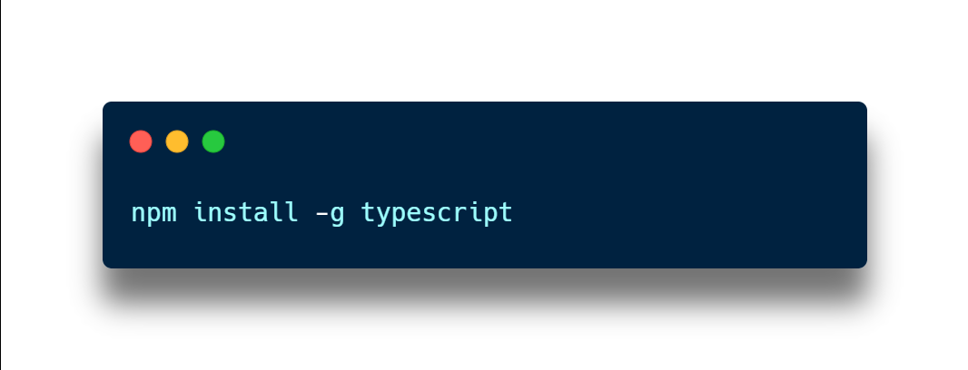
Setting Up TypeScript Environment
Install the TypeScript package globally
The –g flag is indicating that you are installing the Node package globally, and it’s not associated to any specific project.
This package will help compile your TypeScript code into JavaScript.
Note that you can install TypeScript on a project-level, but here it’s done globally.
Notes:
Instructions is written down for the people who won’t be able to make today’s session, or if you get confused later, you can always refer to the written instructions.
It assumes that Node is already installed correctly on your operating system.
The installation is done globally, because I don’t have any preferred configuration for this project so I can use the default compiler.

Slide 12
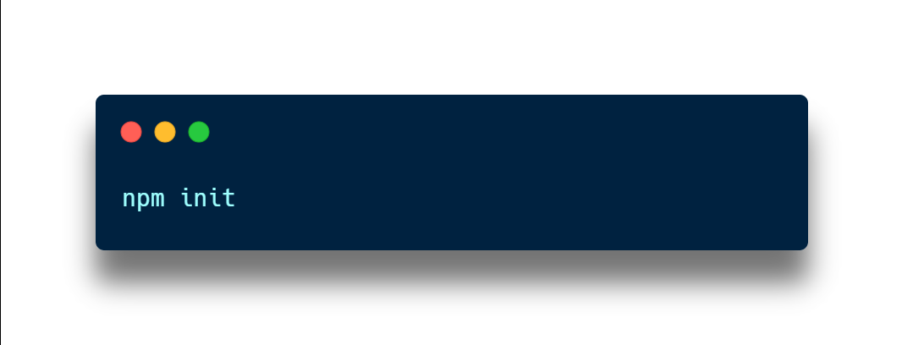
Setting Up TypeScript Environment
Initialize a Node project
Create an empty folder and initialize it as an empty Node project.
Step through the creation wizard by entering the information required.

Slide 13
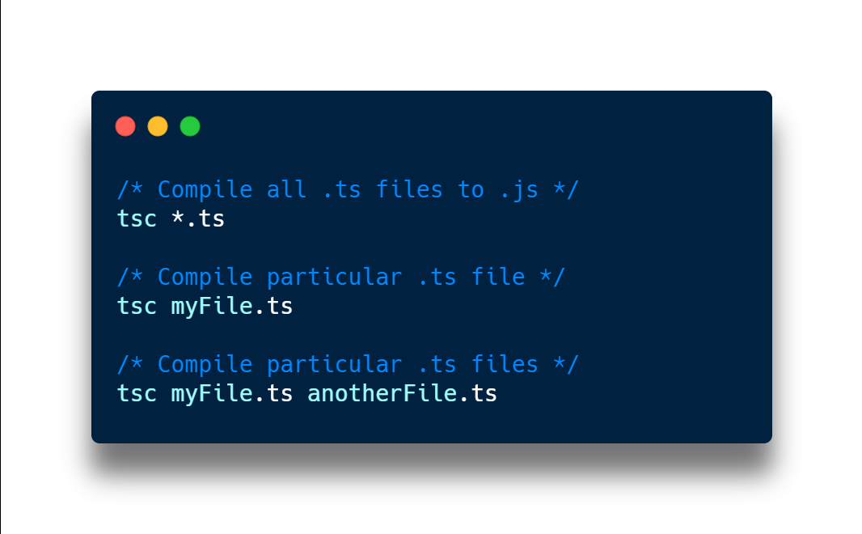
Setting Up TypeScript Environment
Compiling Process
To convert your TypeScript code into JavaScript, run the following command.
Notes:
There are three commands you can choose, depending on whether you want to specify the file to compile.

Slide 14
Variable Types
boolean
These are True/False values.
For example, it can be used for the phrase “Is it raining today?”
number
Represents whole numbers or floating-point values.
string
An array of characters (can be empty).

Slide 15
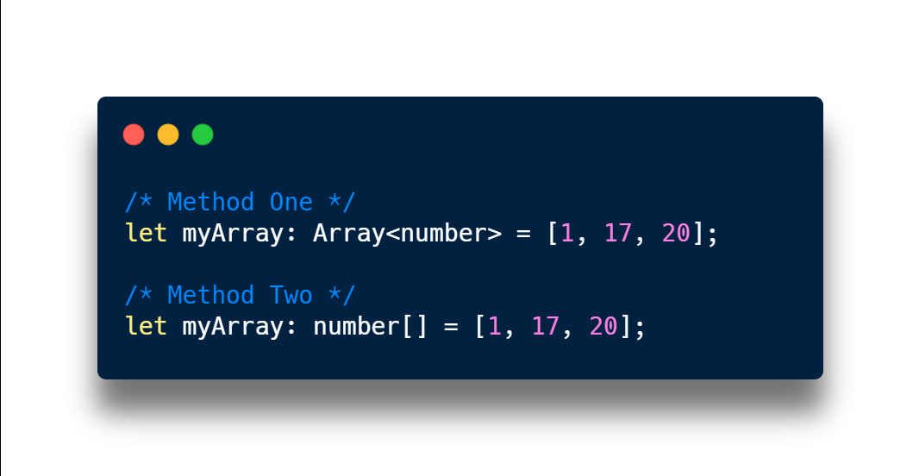
Variable Types
Array
A collection of elements.
You can create an array for any of the datatypes listed on the previous slide.

Slide 16
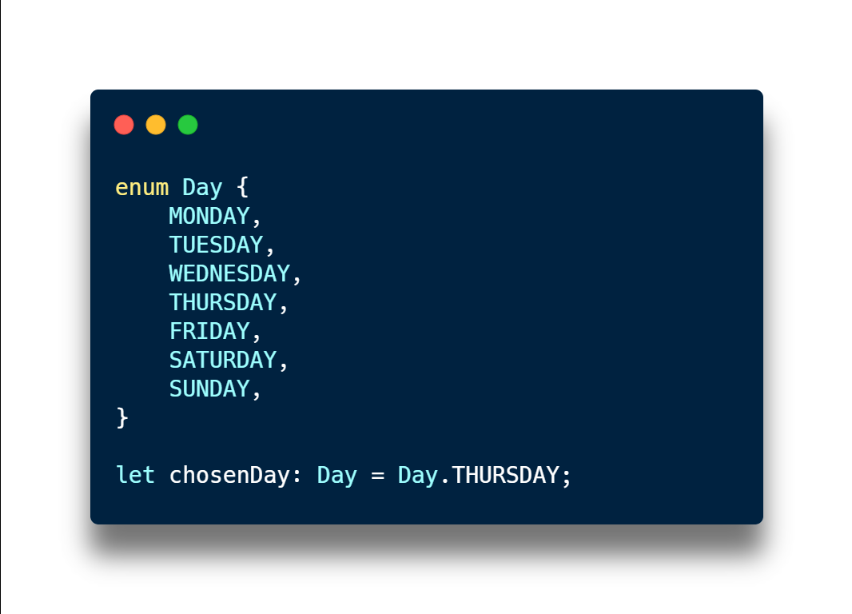
Variable Types
Enums
Helpful extension to the standard datatypes that only allows values from your pre-determined set.

Slide 17
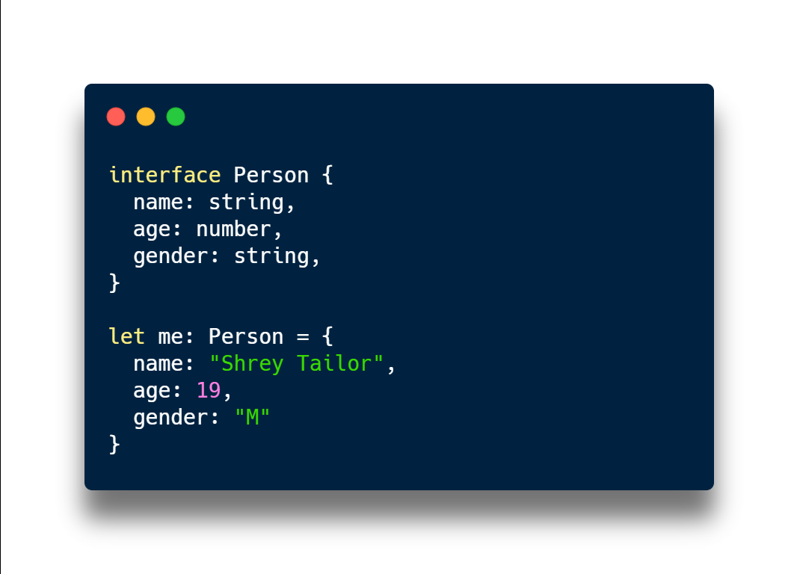
Interfaces
A way to specify a contract which our entities must conform to.
A potential use-case is for arguments to a function.
Popularly used with plain JavaScript objects as function arguments.

Slide 18
Classes
An important aspect of Object-Oriented Programming.
They can represent and model real-world entities in your program using constructs such as Fields, Constructors and Methods.
Classes help to make our code more readable and maintainable.
This is because related pieces of information are encapsulated in one variable, which move together as a whole.

Slide 19
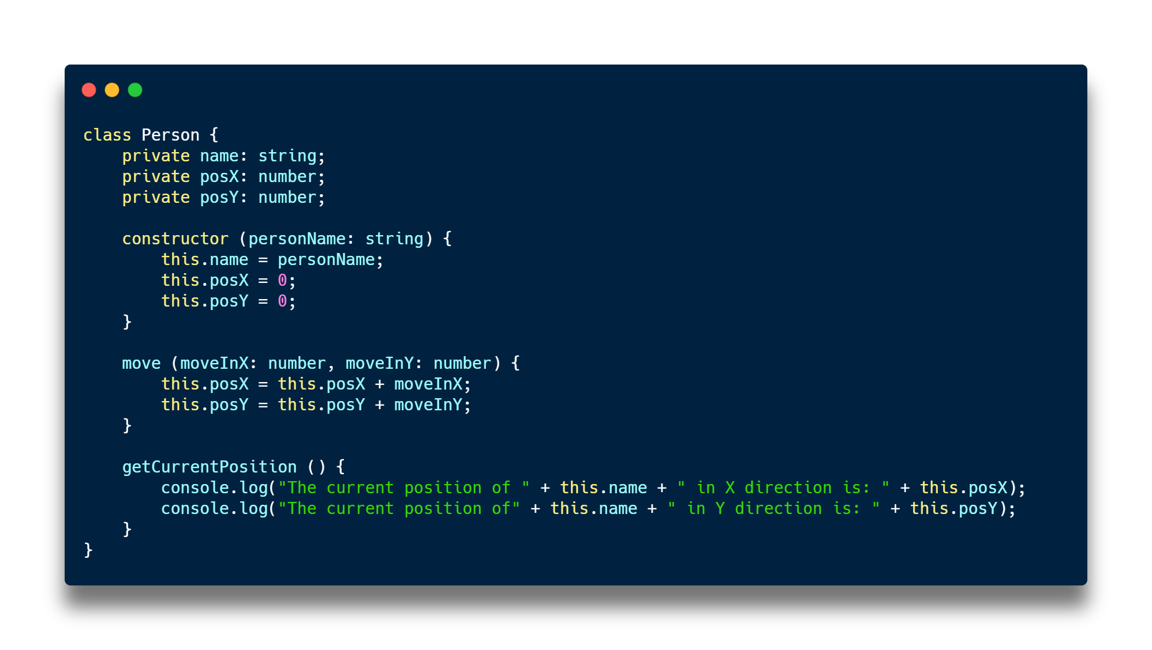
Classes

Slide 20
References/Further Info
TypeScript’s Official Documentation
https://www.typescriptlang.org/
Mozilla Web Docs for JavaScript
https://developer.mozilla.org/en-US/docs/Web/JavaScript/Guide

